Slide 1
I/O Streams and File Handling

Slide 2
Version Control and Revision History
 | Name | Date
Prepared By
Reviewed By
Approved By
Version No. | Date | Affected Sections | Highlights

Slide 3










Iconic Representations.......
Coffee Break
Can you Solve?
FAQ
Test your Memory
Objective
Queries
Demo
Recap
Need more Info
Brainstorm

Slide 4
Objectives
At the end of this module you would be able to understand,
I/O Streams
InputStream and OutputStream
Readers and Writer
File Handling
Serialization
Property Files

Slide 5
I/O Streams and File Handling
The I/O System in Java is based on Streams
What are Streams?
Streams are nothing but “flow of data”
Files are necessary for persisting data and Java views each file as a sequential stream of bytes
Different streams are used to represent different kinds of data flow.
When a file is opened, an object is created and a stream is associated with the object.
Input Stream
Output Stream
Executing Program
Notes:
What are Streams?
In Java IO streams are flows of data you can either read from, or write to.
Streams are typically connected to a data source, or data destination, like a file, network connection etc.
A stream has no concept of an index of the read or written data, like an array does. Nor can you typically move forth and back in a stream, like you can in an array, or in a file using RandomAccessFile.
A stream is just a continuous flow of data.

Slide 6
I/O Streams and File Handling
keyboard
standard input stream
CPU
Standard output stream
MEM
monitor terminal console
file
input stream
HDD
file output stream
files

Slide 7

I/O Streams and File Handling
What are Streams (Contd..)?
Thus, an object from which we can read a sequence of bytes is input stream and the object to which we can write a sequence of bytes is output stream.
it acts as a buffer between the data source and destination
The source or destination of data can be files, network connections or even blocks of memory
The Java I/O class libraries allows user to handle any data in the same way

Slide 8
I/O Streams and File Handling
Stream Classes and subclasses are defined in java.io package
Java has two main types of Streams
Byte Oriented
Each datum is a byte
Abstract Root classes for byte streams:
The InputStream Class
The OutputStream Class
Suitable for reading binary and ASCII data.
Character-based I/O streams
Each datum is a Unicode character
Abstract root classes are:
Reader Class
Writer Class

Slide 9
I/O Streams and File Handling
Binary Vs Text File
All data and programs are ultimately just zeros and ones
each digit can have one of two values, hence binary
bit is one binary digit
byte is a group of eight bits
Text files: the bits represent printable characters
one byte per character for ASCII, the most common code
For example, Java source files are text files so is any file created with a "text editor"
Binary files: the bits represent other types of encoded information, such as executable instructions or numeric data
these files are easily read by the computer but not humans
For example Executable files (created by compiling source files)

Slide 10
I/O Streams and File Handling
Binary Vs Text File(Contd..):
Number: 127 (decimal)
Text file
Three bytes: “1”, “2”, “7”
ASCII (decimal): 49, 50, 55
ASCII (octal): 61, 62, 67
ASCII (binary): 00110001, 00110010, 00110111
Binary file:
One byte (byte): 01111110
Two bytes (short): 00000000 01111110
Four bytes (int): 00000000 00000000 00000000 01111110
Program
I
‘
M
A
S
T
R
I
N
G
\n
Program
01101001
11101101
00000000

Slide 11
IO Streams and File Handling
File IO
Low level I/O
High level I/O
Text file I/O
Treat a file
As a set of bytes
Treat
A file As a set of data of
primitive
Data type
Treat
A file As a set of text
(or String)

Slide 12
I/O Streams and File Handling
Low –Level File IO:
Abstract classes are InputStream and OutputStream
InputStream :
Used to read data from the source
Methods to read Data:
int read():Reads a single character.
int read(byte[] buffer)
Reads bytes and places them into buffer (max = size of buffer)
returns the number of bytes read
int read(byte[] buffer, int offset, int length)
Reads up to length bytes and places them into buffer
First byte read is stored in buffer[offset]
Returns the number of bytes read
available() :returns the number of bytes which can be read without blocking
skip() : skips over a number of bytes in the input stream
close() :close the input stream and release any system resources

Slide 13
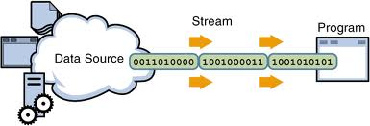
I/O Streams and File Handling
Low –Level File IO(Contd..):
InputStream(Contd..):
close() :close the input stream and release any system resources
input streams optionally support repositioning the stream can mark the stream at a certain point and 'rewind' the stream to that point later.
methods that support repositioning are:
markSupported():returns true if repositioning is supported
mark() :places a mark in the stream
reset() :'rewinds' the stream to a previously set mark

Slide 14
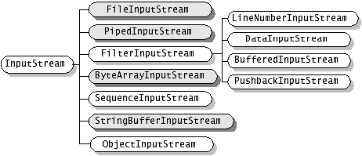
I/O Streams and File Handling
Low –Level File IO (Contd..):

Slide 15
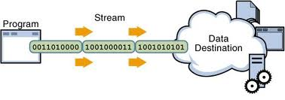
IO Streams and File Handling
Low –Level File IO(Contd..):
OutputStream:
Used to write data to the source
Basic methods of OutputStream:
void write (int b): Writes a single byte to an output stream
void write(byte buffer[])
void write(byte buffer[], int offset, int noBytes)
void flush()
To improve performance, almost all output protocols buffer output.
Data written to a stream is not actually sent until buffering thresholds are met.
Invoking flush() causes the OutputStream to clear its internal buffers.
void close()
Closes stream and releases any system resources.

Slide 16
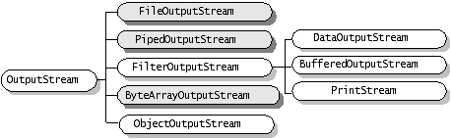
IO Streams and File Handling

Slide 17
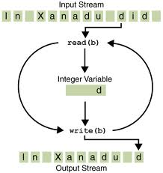
I/O Streams and File Handling
Low –Level File IO(Contd..):
InputStream(Contd..):
InputStream and OutputStream are abstract classes instantiated by subclasses.
FileInputStream & FileOutputStream:
Facilitates reading in an array of bytes and outputs a sequence of bytes in a file
Constructors:
FileInputStream(String filepath)
throws FileNotFoundException
FileInputStream(File fileobj)
throws FileNotFoundException
FileOutputStream(String filepath)
FileOutputStream(File fileobj)

Slide 18

I/O Streams and File Handling
FileInputOutputStreamDemo.java

Slide 19
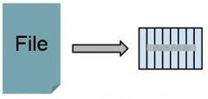
I/O Streams and File Handling
Low –Level File IO(Contd..):
InputStream(Contd..):
ByteArrayInputStream & ByteArrayOutputStream :
uses a byte array as the source
It can be handy if your data is stored in an array, but you have a component that can only process it as an InputStream.
The ByteArrayInputStream can thus wrap the byte array, and turn it into a stream.
Constructors:
ByteArrayInputStream(byte array[])
ByteArrayInputStream(byte array[],int start,int numbytes)

Slide 20
I/O Streams and File Handling
ByteArrayInputOutputDemo.java

Slide 21

I/O Streams and File Handling
Low –Level File IO(Contd..):
InputStream(Contd..):
PipedInputStream & PipedOutputStream:
Pipes are used to channel the output from one program (or thread or code block) into the input of another.
Useful in transfering data between two running processes.
The data written on an OutputStream object is read by an InputStream object. Here, the pipe is a transferring channel and comes with some predefined system dependent buffer memory.

Slide 22
IO Streams and File Handling
PipedInputOutputDemo.java

Slide 23
I/O Streams and File Handling
Low –Level File IO(Contd..):
InputStream(Contd..):
FilterInputStream & FilterOutputStream:
You attach a filtered stream to another stream to filter the data as it's read from or written to the original stream.
The java.io package contains these filtered streams which are subclasses of either FilterInputStream or FilterOutputStream:
DataInputStream and DataOutputStream
BufferedInputStream and BufferedOutputStream
LineNumberInputStream
PushbackInputStream
PrintStream (this is an output stream)
To use a filtered input (output) stream, you attach the filtered stream to another input (output) stream when you create it.

Slide 24
Language Fundamentals
BufferedInputOutputDemo.java

Slide 25

IO Streams and File Handling
Examine the programs executed so far.
“You must have observed that we need to do typecasting everytime we read the data from the file and convert it to the apropriate format!”
“Is there an easy way out of this?“

Slide 26
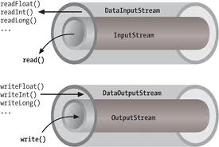
I/O Streams and File Handling
Low –Level File IO(Contd..):
InputStream(Contd..):
DataInputStream & DataOutputStream :
Facilitates to write and read primitive data type to a media such as file.
Both of this class have the corresponding method to write primitive data and read it back without needing to interpret if the read data should be an integer or a float data.

Slide 27
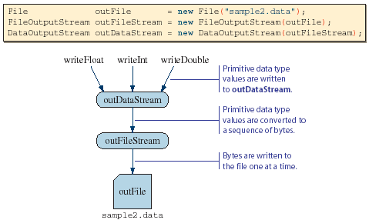
I/O Streams and File Handling
Low –Level File IO(Contd..):
InputStream(Contd..):
DataInputStream & DataOutputStream(Contd..) : Sequence of operations

Slide 28
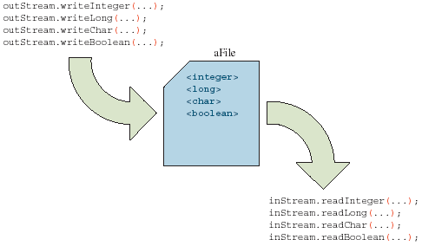
I/O Streams and File Handling
Low –Level File IO(Contd..):
InputStream(Contd..):
DataInputStream & DataOutputStream(Contd..) :
The order of write and read operations must match in order to read the stored primitive data back correctly.

Slide 29
IO Streams and File Handling
DataInputOutputStreamDemo.java

Slide 30
IO Streams and File Handling
“What will happen if I open these files created using InputStream from a text editor?“
“Will it be in human Readable format?“
“How can I create files using my program in Human Readable format?“

Slide 31
IO Streams and File Handling
Text File I/O(Contd..):
Abstract classes are Reader and Writer
Can be used in conjunction with byte-oriented streams:
Use InputStreamReader to "convert" an InputStream to a Reader
Use OutputStreamWriter to "convert" an OutputStream to a Writer
Useful when reading and writing text (character data)
Readers and Writers support a wide variety of character encodings including multi-byte encodings like Unicode.

Slide 32
IO Streams and File Handling
File Class:
An abstract representation of file and directory pathnames
File class doesn’t operate on streams
Represents the pathname of a file or directory in the host file system
Used to obtain or manipulate the information associated with a disk file, such as permissions, time, date, directory path etc
An object of File class provides a handle to a file or directory and can be used to create, rename or delete the entry
Notes:
The API says that the class File is "An abstract representation of file
and directory pathnames." The File class isn't used to actually read or write
data; it's used to work at a higher level, making new empty files, searching for
files, deleting files, making directories, and working with paths.

Slide 33
IO Streams and File Handling
File Class(Contd..)
Some methods
canRead()
exists()
isFile()
isDirectory()
getAbsolutePath()
getName()
getPath()
getParent()
Length() : returns length of file in bytes as long
lastModified()
Mkdir()
List() : obtain listings of directory contents
Notes:
createNewFile()
delete()
exists()
isDirectory()
isFile()
list()
mkdir()
renameTo()

Slide 34
IO Streams and File Handling
FileDemo.java

Slide 35
IO Streams and File Handling
Text File I/O(Contd..):
Reader:
Used to read data:
Methods are:
int read():Reads a single character. Returns it as integer.
int read(char[] buffer) :Reads bytes and places them into buffer (max = size of buffer) and returns the number of bytes read.
int read(char[] buffer, int offset, int length) :Reads up to length bytes and places them into buffer and returns the number of bytes read
close() :method closes the stream
mark(int readAheadLimit):marks the current location.Parameter specifies the number of characters which can be read before the marks becomes invalid
ready() :returns true if there is data to be read from the stream.returns true if the stream is guaranteed not to block upon next read.
reset() :returns the stream to its previously marked location
skip(long n) :skips over n bytes

Slide 36
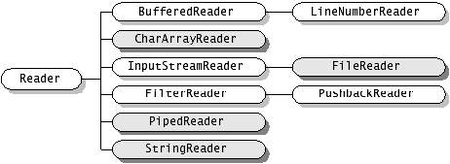
IO Streams and File Handling
Text File I/O(Contd..):
Reader:

Slide 37
IO Streams and File Handling
Text File I/O(Contd..):
Writer:
Used to write data.
Methods are:
void write(int c) :Writes a single character.
void write(char[] buffer):Writes an array of characters
void write(char[] buffer, int offset, int length):Writes a portion of an array of characters and length indicates how many characters to write.
void write(String aString):Writes aString to the stream
void write(String aString, int offset, int length):Writes a portion of a String to the stream.

Slide 38
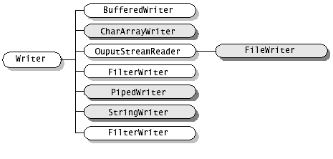
IO Streams and File Handling
Text File I/O(Contd..):
Writer(Contd...):

Slide 39
IO Streams and File Handling
Text File I/O(Contd..):
Reader and Writer:
Reader and Writer are abstract classes and the subclass implementations are:
FileReader and Writer:
conveniet class to provide a character based stream from file.
Alternatively, open the file using a FileInputStream and then pass that stream to an InputStreamReader instance.
BufferedReader and BufferedWriter:
Reads text from the character input stream
Provides buffering to provide efficient reading of characters, arrays and lines.
LineNumberReader (subclass of BufferedReader):
A stream which keeps track of how many lines there have been
Line numbering begins at 0. Whenever the LineNumberReader encounters a line terminator in the characters returned by the wrapped Reader, the line number is incremented.

Slide 40
IO Streams and File Handling
FileReaderWriterDemo.java
LineNumberReaderDemo.java

Slide 41
IO Streams and File Handling
Text File I/O(Contd..):
Reader and Writer:
StringReader & StringWriter:
Provides a character stream where the data is obtained from a String
PushbackReader (subclass of FilterReader):
A stream which allows characters to be pushed back into the stream after being read
The number of characters which can be pushed back is specified when instantiated. Default = 1

Slide 42
IO Streams and File Handling
PushBackReaderDemo.java

Slide 43
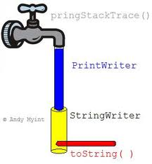
IO Streams and File Handling
Text File I/O(Contd..):
Reader and Writer(Contd..):
PrintWriter
Introduced in Java5.
enables you to write formatted data to an underlying Writer.
For instance, writing int, long and other primtive data formatted as text, rather than as their byte values.
Provides print() and println() methods for standard output and are overloaded to take a variety of types
When println is used, the stream will output the appropriate sequence for the current platform
System.out and System.err are PrintWriters
The PrintWriter class contains the powerful format() and printf() methods which allow you to mix text and data in very advanced ways, using a formatting string.

Slide 44
IO Streams and File Handling
PrintWriterDemo.java
Student.java
ScannerToFile.java(Using Scanner Class to write to file)

Slide 45
Serialization

Slide 46
IO Streams and File Handling
Serialization:
You can also read and write objects to files
Object I/O goes by serialization
Serialization is the process of saving an object in a storage medium (such as a file, or a memory buffer) or to transmit it over a network connection in binary form.
The serialized objects are JVM independent and can be re-serialized by any JVM.
This process of serializing an object is also called deflating or marshalling an object.

Slide 47
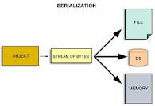
IO Streams and File Handling
Serialization( Contd..):
In this case the "in memory" java objects state are converted into a byte stream. This type of the file can not be understood by the user. It is a special types of object i.e. reused by the JVM (Java Virtual Machine).
FILE
OBJECT
STREAM OF BYTES
DB
MEMORY

Slide 48
IO Streams and File Handling
Serialization(Contd..):
Conditions for Serializing an Object:
If an object is to be serialized:
The class must be declared as public
The class must implement Serializable
The class must have a no-argument constructor
All fields of the class must be serializable: either primitive types or serializable objects
Java serialization does not cannot occur for transient or static fields. Marking the field transient prevents the state from being written to the stream and from being restored during deserialization.
After serializing an object to read/write it into the file make use of ObjectInputStream and ObjectOutputStream classes.
Note: Have a look at the Serializable Interface in Javadocs

Slide 49
IO Streams and File Handling
Examine the Serializable Interface in Javadocs
“The Serializable interface does not define any methods!”
“What possible use is there for an interface that does not declare any methods?“
Serializable is used as flag to tell Java it needs to do extra work with this class

Slide 50
Language Fundamentals
PersonDetails.java
PersonPersist.java(Serializing)
GetPersonDetails.java(De-Serializing)

Slide 51
IO Streams and File Handling
Consider the following scenario:
“ You are required to create an application software that can be used to compress, encrypt, transmit, receive, and finally store the data in a remote file”
“What will be your approach?“

Slide 52
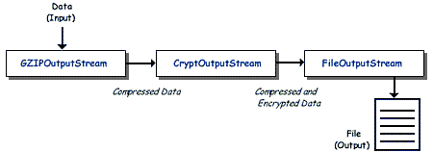
IO Streams and File Handling
Chaining Of Streams:
One of the most convenient features of the I/O stream classes is that they are designed to work together via stream chaining.
Stream chaining is a way of connecting several stream classes together to get the data in the form required.
Each class performs a specific task on the data and forwards it to the next class in the chain.

Slide 53
IO Streams and File Handling
Chaining of Streams(Contd..)
It can be done as:
FileOutputStream fos = new FileOutputStream("myfile.out"); CryptOutputStream cos = new CryptOutputStream(fos); GZIPOutputStream gos = new GZIPOutputStream(cos);
or simply:
GZIPOutputStream gos = new
GZIPOutputStream(
new CryptOutputStream(
new FileOutputStream("myfile.out")));

Slide 54
Java Property Files

Slide 55
IO Streams and File Handling
Property Files:
Property files in Java are normally used to store the configurable parameters
For e.g. values like JDBC connectivity parameter or user preferences settings
Properties file in Java is a text file which stores data in form of key and value, key being known as property
java.util.Properties is a platform-independent generalization of the DOS SET environment, or the Windows *.INI files.
The Properties class represents a persistent set of properties. The Properties can be saved to path from where the properties file would be picked up.
Each key and its corresponding value in the property list is a string

Slide 56
IO Streams and File Handling
Property files(Contd..)
Properties can be categorized as:
System properties:
System properties give information about the environment of the program ,in which it is running such as JVM it is running in, Operating System name and version, java home and many more properties.
Read from the System class.
User specific properties:
These properties are part of the .properties file containing a key value pair, which can be mentioned by the program in run
#application.properties file contents
password=tiger
url=jdbc:oracle:thin:@oratrgsrv:1521:oracle8i
driver=oracle.jdbc.driver.OracleDriver
username=scott

Slide 57
IO Streams and File Handling
Property Files(Contd..):
Property Class Methods:
Load(): Use to load the properties
store(): Add new property to the .properties file.
setProperty() & getProperty() : Getting and Setting the property values.

Slide 58
Language Fundamentals
SystemPropertiesDemo.java
UserDefinedPropertiesDemo.java(Use the file jdbc.properties)

Slide 59

Summary
The java.io package contains many classes that your programs can use to read and write data.
Most of the classes implement sequential access streams. The sequential access streams can be divided into two groups:
those that read and write bytes and
those that read and write Unicode characters.
Each sequential access stream has a speciality, such as reading from or writing to a file, filtering data as its read or written, or serializing an object.

Slide 60
Questions
State True/ False
The following two statements will associate file 1 and file 2 to the same file:
File file1=new File(“c:\\Files\\Data”,”Emp.dat”);
File file2 = new File(“c:\\Files\\Data\\Emp.dat”);
True
.

Slide 61
Questions
How do I check end of file while reading from a stream?
If you are reading with the read() method of InputStream/Reader, this will return -1 on EOF. If however you are using BufferedReader.readLine(), then this will return null on end of file.
.

